Slide 1

Your Ultimate Health Buddy
“Wero”
Soonchunhyang University
Team Wero
Notes:
ㅇㄹㅇㄹㅇㄹㅇ

Slide 2

INDEX
Team Introduction
Sustainable Development Goals
About “Health”
Application “Wero”
Application Features
Skills
Architecture
Expected Effect

Slide 3




TEAM MEMBER
CHOI MINYE
SON MINKI
Role : Design
Role : Machine Learning
HAN JEONGBEOM
KIM SEONGHO
Role : App
Role : Back-End

Slide 4
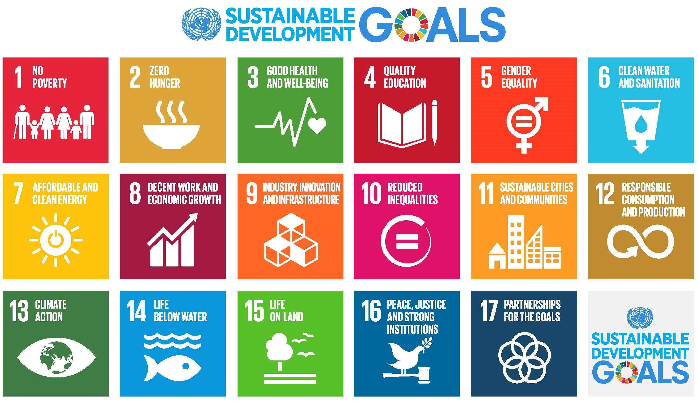

Slide 5
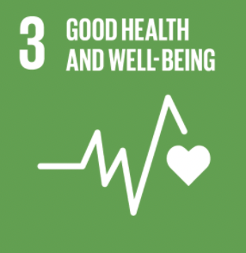
Our Goals
Good Health and Well-Being
Team wero aims to ensure health and promote the welfare of
people of all ages.
These days, modern people do not show and express their
emotions well, so it has been confirmed that mental fatigue
increases and affects the body.
In this situation, we developed wero, an application that can
manage physical health as well as mental health, and furthermore build consensus based on physical and health levels rather than specific age groups.

Slide 6

What is health?
Health refers to a state in which the body and mind are functioning well without any pain or discomfort. It signifies complete functioning and well-being in terms of an individual's physiological, psychological, and social aspects. Health is associated with vitality, energy, and quality of life that we experience on a daily basis.
Physical
Social
Mental

Slide 7

The importance of health
The importance of health is becoming
increasingly emphasized in today's society.
Health is one of the most important values
in our lives.
When we have good health, we can do more
and lead a happier life.
On the other hand, if our health is poor, we
may experience discomfort in daily life and
our quality of life may decline.
Maintaining good health is one of the most
important factors that can enhance the
overall happiness and quality of our lives.

Slide 8

Physical Health
Physical health refers to the state of the body being healthy and full of energy.
Maintaining physical health is important through regular exercise and proper eating
habits, among other factors.
When physical health is good, individuals can do more in their daily lives, and having a
healthy body is necessary for maintaining good mental health as well.

Slide 9

Mental Health
Mental health refers to a healthy and stable state of mind.
Maintaining mental health requires managing stress, getting enough rest and sleep,
and practicing proper self-care, among other things.
Good mental health leads to a happier life and can also contribute to maintaining
good physical health.

Slide 10

Current interest in health
There is a growing global interest in both physical and mental health.
People in their 20s and 30s are showing a rapid increase in interest in health.
Our physical health as well as our mental health is affected by everyday stress and emotional pain.
For these reasons, many people are now striving to manage not only their physical health but also their mental health.

Slide 11
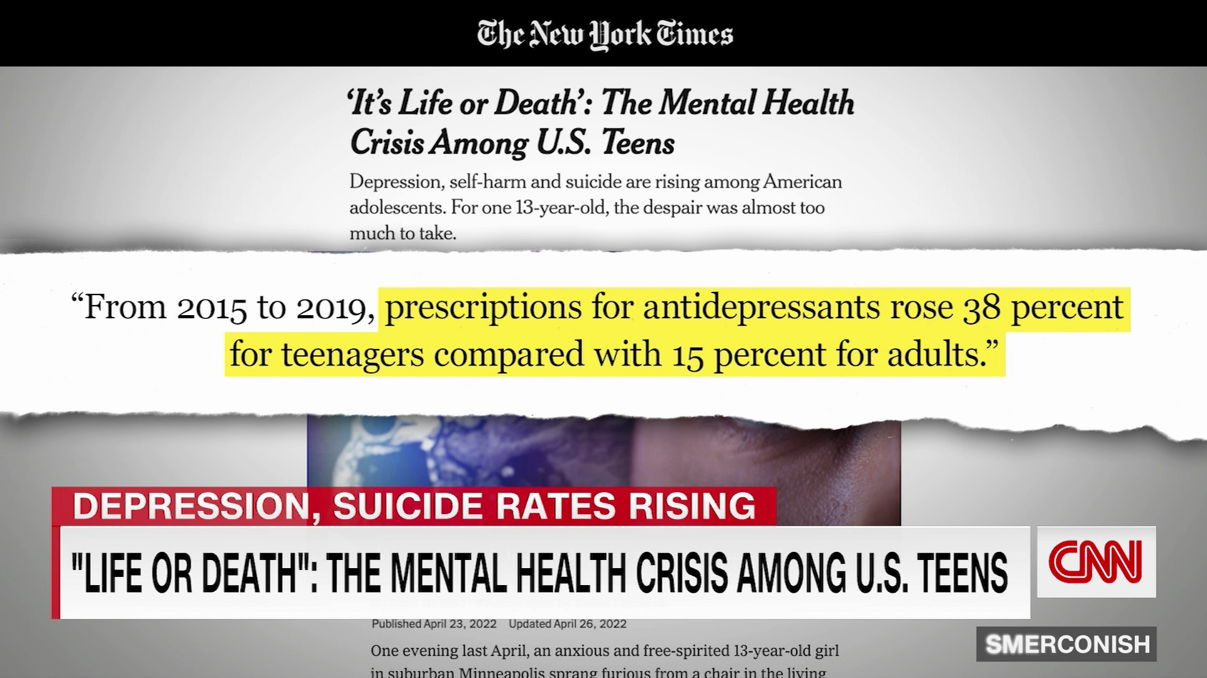
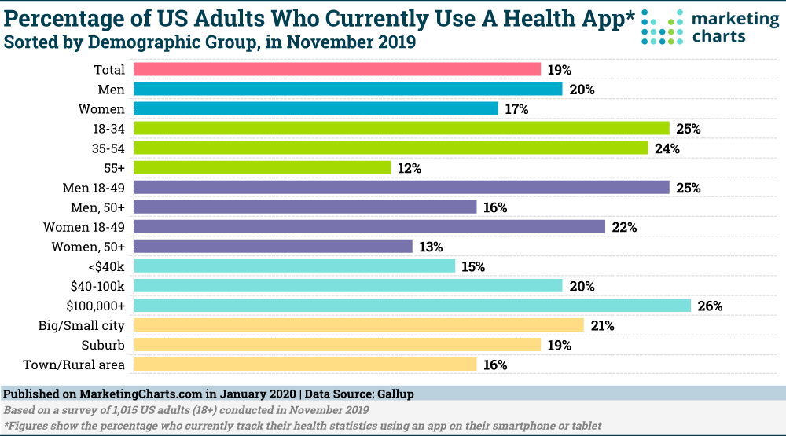

Slide 12
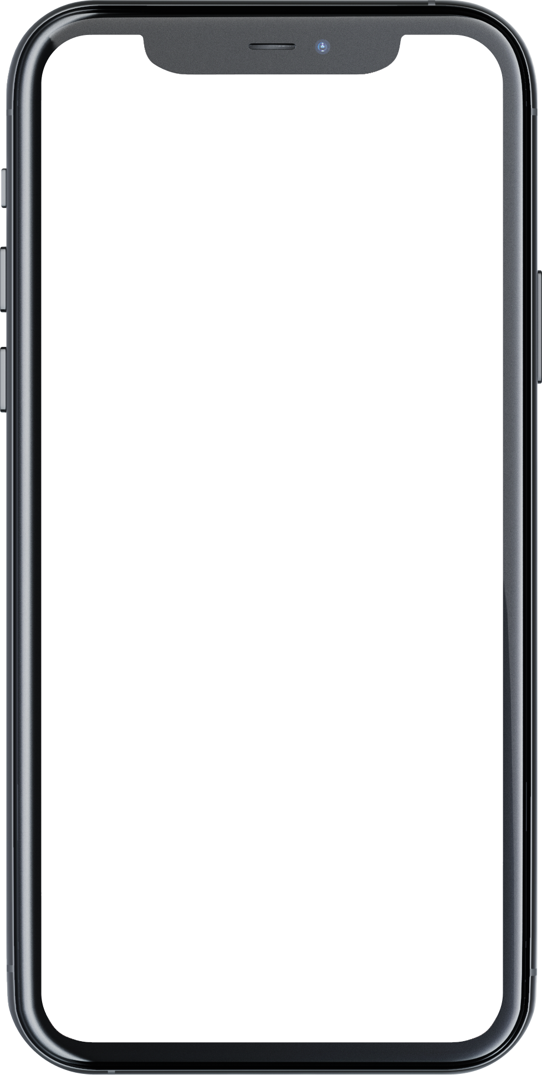
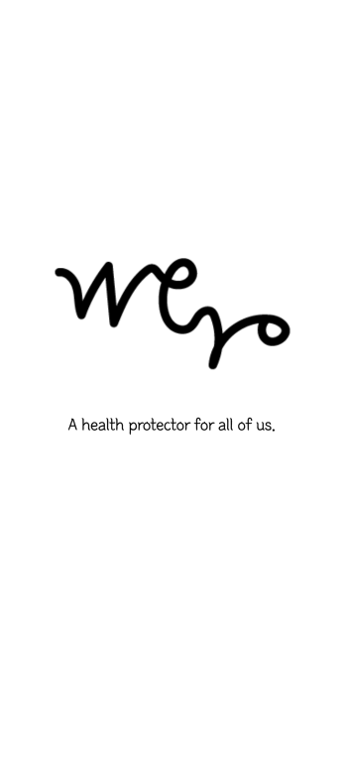
Wero
We Are Around U
When you feel tired and exhausted, join us.
"I'm always waiting for you in this place."
App features
PATI Test
Daily Test & Graph
Diary
Notice Board
Recommendation
Group Therapy

Slide 13
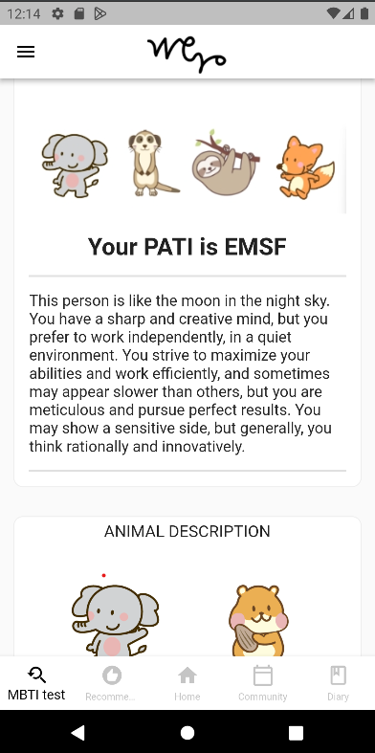
PATI(Pleasant Animal Type Indicator)
The existing MBTI has been transformed into PATI, which is WERO's MBTI.
You can check the PATI type corresponding to your physical and mental health through a 50-question test.
- Defining PATI Criteria
- Physical health: Eating habits, activities
- Mental health: Self-esteem, interpersonal relationships
Define PATI type through animals
Eating habits (E, H) (elephant, hamster)
activity (B, S) (Beagle, Sloth)
Self-esteem (L, M) (Lion, Meerkat)
interpersonal relationships (C, F) (Cafibara, Fox)

Slide 14
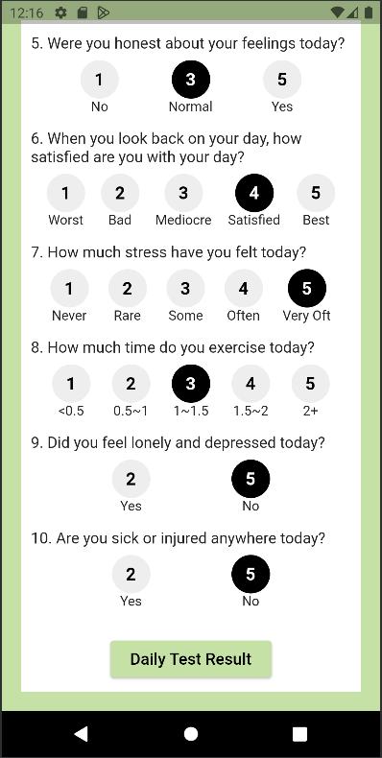
Daily Test & Graph
Test with 10 questions and mood emoticons
You can check your mental and physical health
through daily tests.
- Provides supportive feedback on accumulated
scores and moods (emoticon) for 7 days.
- You can check the score earned through the Daily
Test on the graph for 7 days.

Slide 15
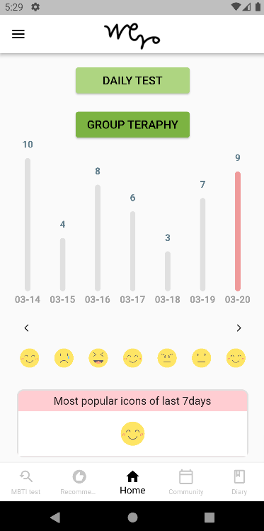
Daily Test & Graph
Test with 10 questions and mood emoticons
You can check your mental and physical health
through daily tests.
- Provides supportive feedback on accumulated
scores and moods (emoticon) for 7 days.
- You can check the score earned through the Daily
Test on the graph for 7 days.

Slide 16
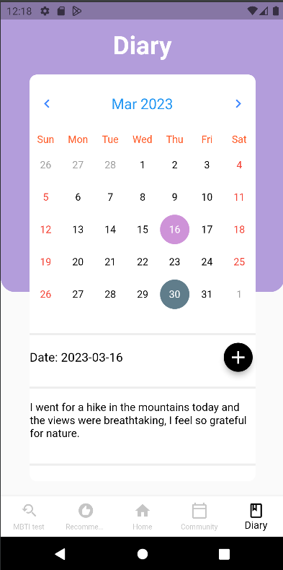
Diary
You can look up the diary on the calendar.
- You can't modify it to remember how you felt that
day.

Slide 17
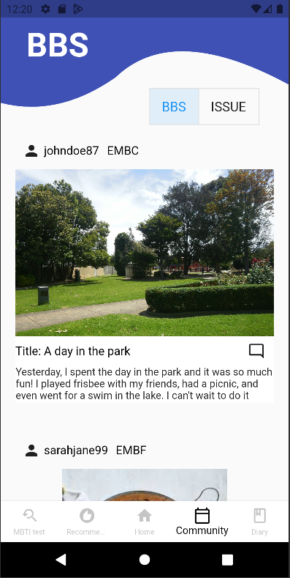
Notice Board
Provides news about mental and physical health.
You can post concerns about your body and health and
communicate through comments.
Posts and comments can create a consensus by exposing
the author's PATI.
- Check the issues that are considered a lot by PATI
(further development)

Slide 18
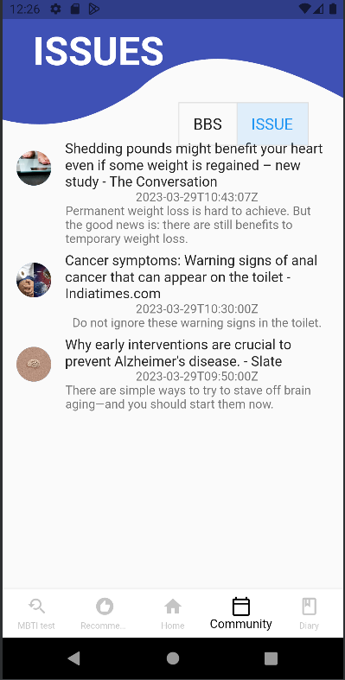
Notice Board
Provides news about mental and physical health.
You can post concerns about your body and health and
communicate through comments.
Posts and comments can create a consensus by exposing
the author's PATI.
- Check the issues that are considered a lot by PATI
(further development)

Slide 19
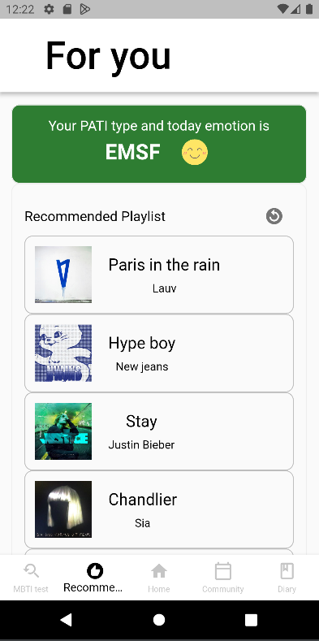
Recommendation
- Recommend songs based on PATI
- Recommend songs based on the mood of daily test

Slide 20
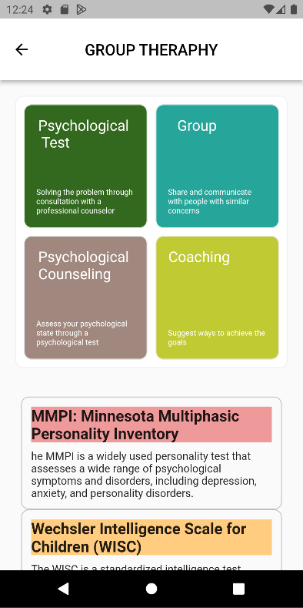
Group Therapy
The group therapy will be developed later!
Consultation is conducted through actual
psychologists and coaches.
Group therapy by PATI is available.
- You can consult based on professional psychological
tests and psychological test results.

Slide 21
Skills
Backend
Frontend
Machine Learning
Java 11
Spring Boot 2.7.6
Spring Security 2.7.6
Spring Data JPA
Gradle 7.6.1
Swagger 3.0
JWT 0.11.2
MySQL 8.0.2
DBeaver
Intellij
Google Cloud Platform(GCP)
Flutter 3.7.5
Dart 2.19.2
Python 3.8.8
Tensorflow 2.11.0
Keras 2.11.0
Numpy 1.21.0
Pandas 1.2.3

Slide 22






Google Technology
- Google Cloud Platform(GCP)
- Compute Engine
- SQL
- Cloud Storage
- API & Services
- Cloud DNS
- Flutter
- Dart

Slide 23
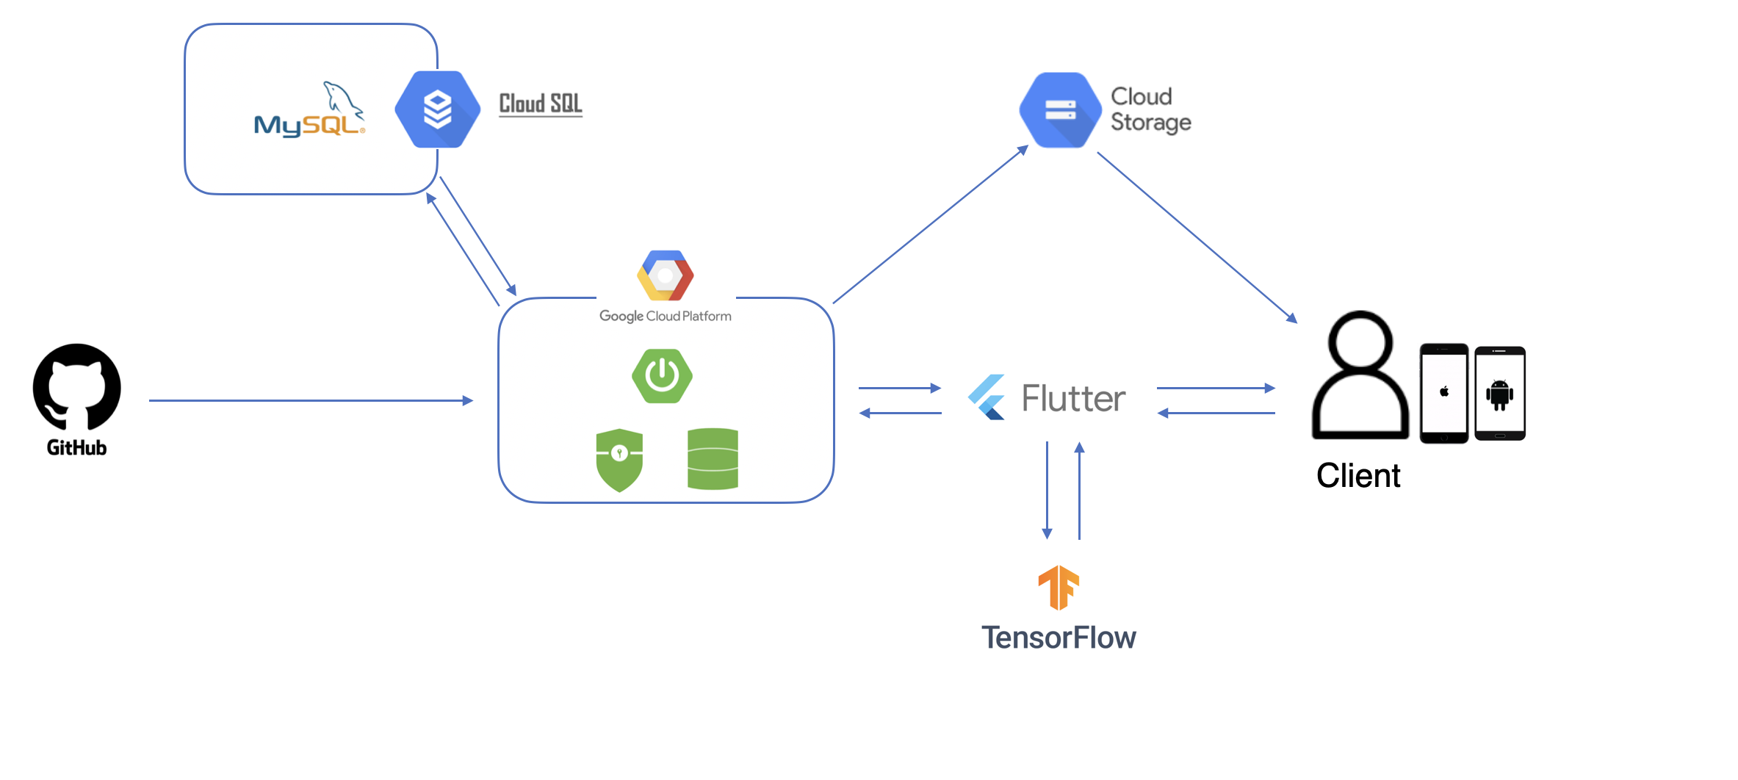
Architecture

Slide 24
Better Lifestyle Habits
Using health applications can improve dietary habits, exercise routines, and sleep habits, ultimately leading to a healthier lifestyle.
Stress Reduction
Applications equipped with stress management features can help users manage and reduce stress more effectively.
Personalized Advice
Health applications can provide tailored advice based on the user's health status, allowing them to discover individualized health management strategies.
Healthy Social Relationships
Health applications can assist users in maintaining healthy social relationships.
Expected Effect

Slide 25
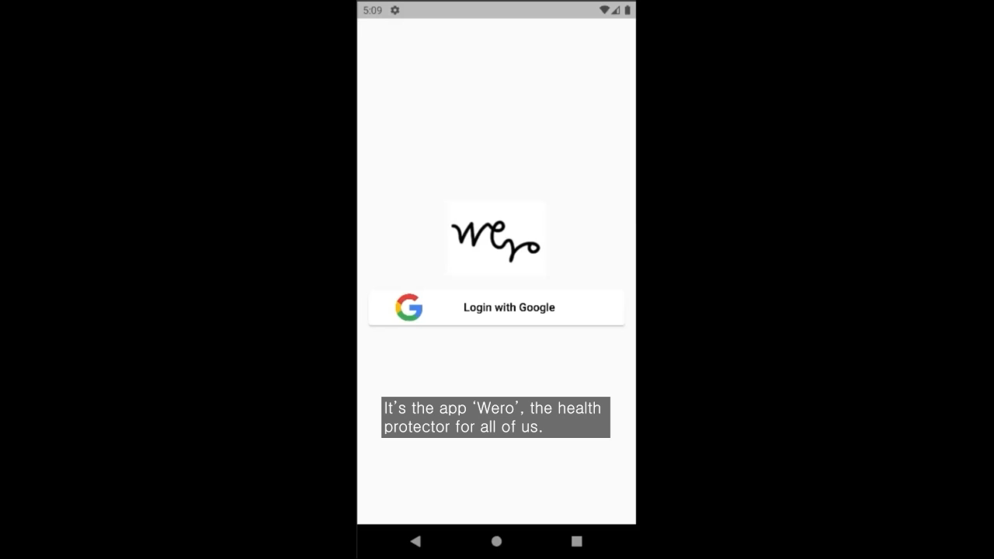

Slide 26

Thank you

